Slide 1
Cloud Computing Assignment Final Part - GoGreen
William Carey
C16315253
DT228-3

Slide 2
VPC Details
VPC | Region | Purpose | Subnets | AZs
1 | US-West 1 EU-West 2 | Production | 6 | 2
2 | Same as above | Test / Development | 6 | 2
Subnet Name | VPC | Subnet Type (Public/Private) | AZ
Private App 1 | 1 & 2 | Private | 1
Private App 2 | 1 & 2 | Private | 2
Private Web 1 | 1 & 2 | Private | 1
Private Web 2 | 1 & 2 | Private | 2
Private DB 1 | 1 & 2 | Private | 1
Private DB 2 | 1 & 2 | Private | 2

Slide 3
Security Details
Security Group | SG Name | Rule | Source
ELB load Balancer | Elb-sg | Allow 443 | 0.0.0.0/0
Web Tier | Web-sg | Allow 8080 | ELB
App Tier | App-sg | Allow 8080 | Web tier
Database Tier | Db-sg | Allow 1433 | App tier
Other Security Options | Justification
VPC Route Table | Ensuring the specific traffic are routed to their designated locations
Network Access Control Lists | This is to protect the subnet levels by acting as a firewall for the stateless servers, controlling the (in/out) bound traffic at subnet level
AWS Marketplace | For any more Necessary Security benefits, the Marketplace can offer several Appliances

Slide 4
Encryption Options
Requirements | Solution
Encryption option for data at rest | Enable the Amazon S3 Server Side encryption with S3 managed Keys EBS encryption using Block Level, such as Loop-AES Enable the data to be encrypted before it reached the RDS Storage Enable the Key Managed services to managed the Keys associated with the Encryption
Encryption option for data in transit | Enable Secure Socket Layer & Transport Layer Security Client Side Encryption using the AWS KMS-Managed Customer Master Key

Slide 5
Instance Details
Tier | AMI | Tag | Type | Size | Justification | # of Instances
Web | Amazon Linux | Key: Name Value: app-tier | T2 | Large | By expanding the size from what the server from its previous size to this new larger size, we expect the server capacity to reduce from 90% to between 50 and 60 percentage at all times | 6
App | Amazon Linux | Key: Name Value: web-tier | R5 | 2xLarge | By expanding the size from what the server from its previous size to this new larger size, we expect the server capacity to reduce from 90% to between 50 and 60 percentage at all times | 6
DB | N/A | N/A | DB.R5 | 2xLarge | Since there is not a problem currently, we can design to match current size, which also matches the physical resource size. This can be resized later if necessary | N/A

Slide 6
RPO Options
Q: How would you achieve a Recovery Point Objective of four hours?
Since all the servers that the users are connecting to are stateless, We can create images dynamically every four hours of the EB2, and the RDS, and save them inside the RDS Database.
Document Storage
Storage/Archive Options | Detail
Amazon S3 | Store Pictures for three months as they are frequently requested during this time. A rule that after the three months are moved to Amazon Glacier for Long term storage
Amazon Glacier | The storage details for pictures and documents for 4 years nine months. A Policy in delete them after the time length as they are no longer needed and would be outdated by that time

Slide 7
Web Tier Requirements
Requirements | Solution
Architecture must be flexible and handle any peak in traffic or performance. | Enable the Web Tier design to scale in or out depending on the CloudWatch configuration
The overall acceptable incoming network bandwidth is between 300 Mbps and 750 Mbps. | Configure CloudWatch so that it ensures the Auto Scale starts new Web servers when the incoming network bandwidth reaches above the750 MBS for approximately 10 - 15 minutes to allow a little bit of flexibility. If the MBS falls below 300, We set a timer for between 10 & 15 minutes for terminating the web servers that are not needed. This is to save some of the costs and to ensure we do not have Auto Scaling Thrashing
Application administrators want to be notified by email if there are more than 100 “400 HTTP errors” per minute in the application. | Configure CloudWatch to log the 400 HTTP errors per minute in the Application and set up a Alarm for such case. If the error does occur, send a notification to the Application Administrators.

Slide 8
App Tier Requirements
Requirements | Solution
Architecture must be flexible and handle any peak in traffic or performance. | Enable the App Tier design to scale in or out depending on the CloudWatch configuration
Overall memory and CPU utilization should not go above 80% and 75% respectively or below 30% for either. | Configure CloudWatch so that it ensures the Auto Scale starts new App servers when the overall memory utilization reaches above the 80% and the CPU when that goes above 75% for approximately 10 - 15 minutes to allow for some heavy computing work. If the Percentage falls below 30, We set a timer for ten to fifteen minutes for terminating the web servers that are not needed. This is to save some of the costs and to ensure we do not have Auto Scaling Thrashing
Internet access is required for patching and updates without exposing the servers. | Ensuring that the NAT and the VPC routing table are configured properly to reroute the traffic to an available subnets & gateways before working on the patches and updates for the application

Slide 9
Database Tier Requirements
Requirements | Solution
Database needs consistent storage performance at 21,000 IOPS. | Create the RDS to use Provisioned IOPS / SDD Storage as that has the Max IPOS / Volume of 32,000
High availability is a requirement. | Ensure that there is a main RDS in one of the Multi-Zone deployments Zones and a secondary one in another zone that is synchronised to store the same data
No change to the database schema can be made at this time. | Ensure the MySQL 5.6.22 is chosen in the creation of the RDS so the process of the migration from Physical to virtual / Cloud services for the Database is smooth

Slide 10
Additional Services
IAM:
Group :
Cloud Team only have Access to AWS services
Sale Personals use instances to read and write to S3 products in regard to images and the document

Slide 11
Cost Considerations
According to the Assignment document, this part is optional

Slide 12
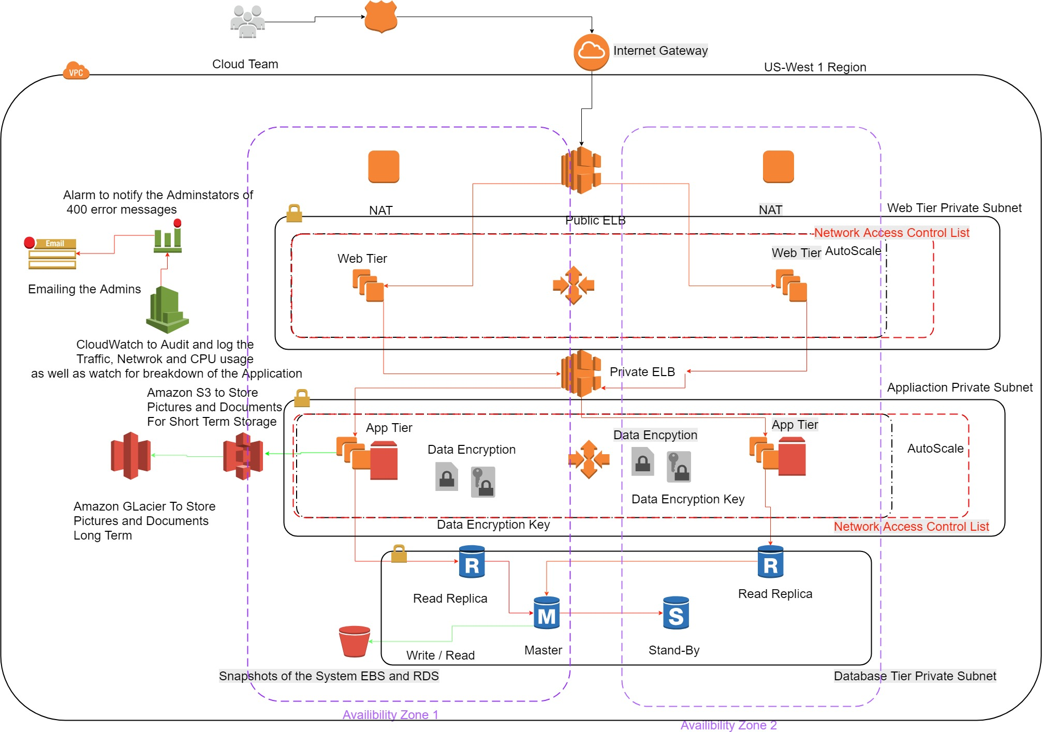
Proposed Architecture Diagram

